Slide 1


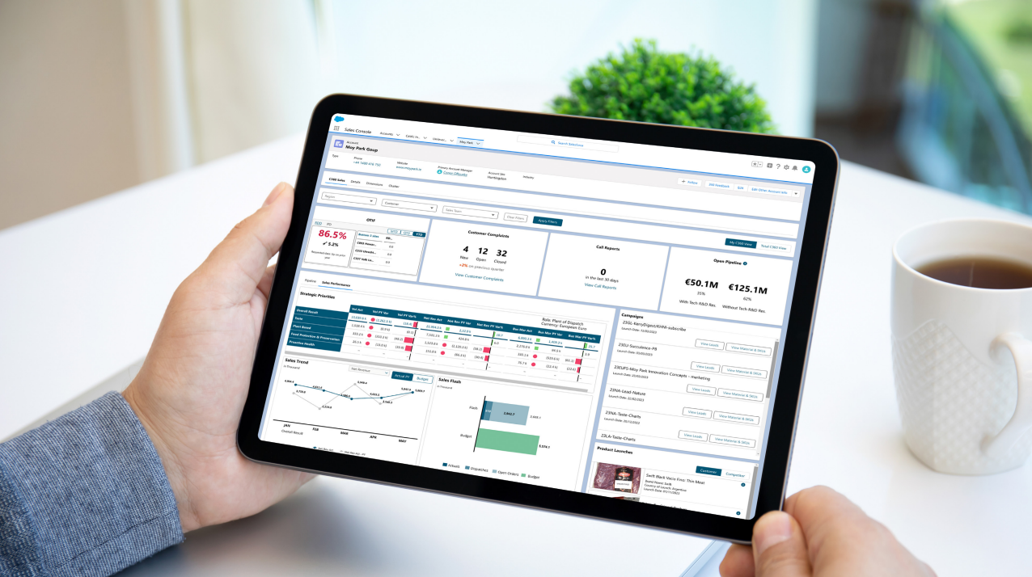

Product Launch
Foundry Kick-Off
Salesforce
C360 Sales
June 5th 2024

Slide 2


Welcome!
$\text{© }$Kerry 2024 | 2

Slide 3
KICK-OFF OUTLINE
SESSION 1
SESSION 1
Product vision, history and future
Proposed delivery timeline
Foundry introduction
SESSION 2
Ways of working
SESSION 2
SESSION 3
SESSION 2
Ways of working continued
Closing Q&A
BREAK 1 | 15mins for tea, coffee, water, snacks
BREAK 2 | 15 mins for tea, coffee, water, snacks
OUR ASK OF YOU
Stay Engaged: Feel free to ask questions and share your thoughts. We value your input, whether during the session, via Teams or by leaving sticky notes on your table.
Minimize Device Use: Wherever you can, avoid using laptops and phones in the meeting room. If needed, please step outside briefly.
Remember, active participation makes the session more enjoyable for everyone!

Slide 4

Moving forward
SESSION 1

Slide 5
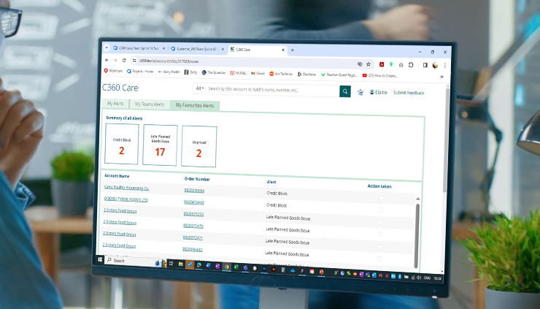
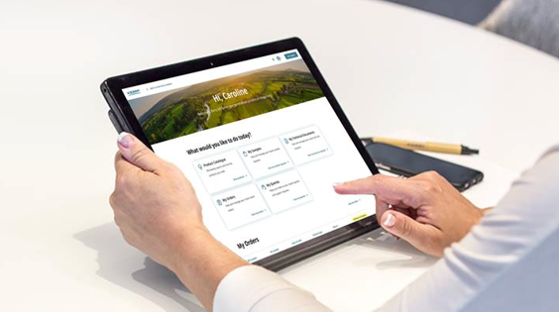
Driving Excellence Through Commercial Digital Enablement
C360 Care
Salesforce C360 Sales
KerryNow
Created for Customer Care | Created for Sales | Created for Customers
Real-time access to customer orders, cases, order lifecycle status, complaints, alerts & business terms | Visibility of customer performance information, insights, product recommendations and leads | Enhanced self-serve portal tailored to the Customers specific needs to connect with Kerry 24/7
Globally launched and used in all Regions Continuous Improvements | MVP in use with 12 Strategic Growth Customers by 70 Salespeople. MSP will be scaled to all Strategic Customers | MSP with Azelis & Caldic (Europe) and KerrySelect (NA). Launched Vogler (LATAM) Will be scaled to other Customers
Delivering service excellence
Managing pipeline & performance
Driving growth
Notes:
In 2023 made we made significant progress – standing up digital products, building the capabilities in our products teams and changing behaviours.
C360 Care real time access to orders , order life cycle , alerts
100% adoption
Response time increased by 51%
Making it easier for our people – direct benefit to customers , faster response times, proactive communication
Customer Loyalty
C360 Sales
Answering Ourvoice feedback
MVP – one destination for information through a customer lens
Richer conversations with our customers
Sales performance / Pipeline management more effectvively
Opportunity to unlock growth
KerryNow
We listened to our customers and distributors
They told us they needed transparency and to access information when they needed
In 2023 we focused on Customer journeys and specifically within our distribution channel
We met with 3 of our strategic distribution partners and openly discussed where digital – self serve portal can add value to support engagement with customers to ultimately been enabler for growth
We mapped out the journeys , the job stories , the pain points and the use cases
We identified the high value functionality
We engaged with an external partner and built a product team with focus on building capabilities whilst building an MVP.
We understood the importance of customer , product data and content and stood up enabling workstreams to ensure we every front end interaction was supported
This was critical to being successful and unlocking value
And with that we brought to life our new customer portal which I would like to play a short video and introduce you to KerryNow

Slide 6

Salesforce C360 Sales
Part of our digital enablement journey to make it easier, faster, and more reliable to access information
All key customer information on one page to build customer intimacy & drive profitable growth
More efficient and easier to provide proactive solutions and grow business
Being used by 70 Salespeople across 12 Strategic Growth Customers
Diageo, JBS, InterSnack, ABinBev, Grupo Bimbo, McDonalds, Mondelez, Nabati, Nestle, PepsiCo, Starbucks, Tyson
What It Offers:
Visibility of customer performance information, past, present, and future to guide decisions.
Access to campaign leads and product recommendations tailored for the customer to drive shift of portfolio.
Offers industry and marketplace insights to initiate proactiveness and responsiveness.
“
To have access to information quickly is of huge value because we're being paid to talk with customers, work with our teams internally, to get things in front of customers that they want and can use to solve problems, versus spending time searching, collating information and crunching numbers. Having access to real-time analysed information makes it easier to do what I do best … Sell!
“
Same information as the source, just easier to access in C360 Sales
Synopsis of feedback heard from Account Managers
Notes:
Makes is easier to access real-time information and remove the need to use multiple systems.
Part of our digital enablement journey to make it easier, faster, and more reliable for our Salespeople to access the data they need
Access all key customer information on one page to build customer intimacy, drive profitable growth, and deliver an improved customer experience.
Saves time searching, collating, and filtering information and makes it easier to provide proactive solutions and grow business.

Slide 7
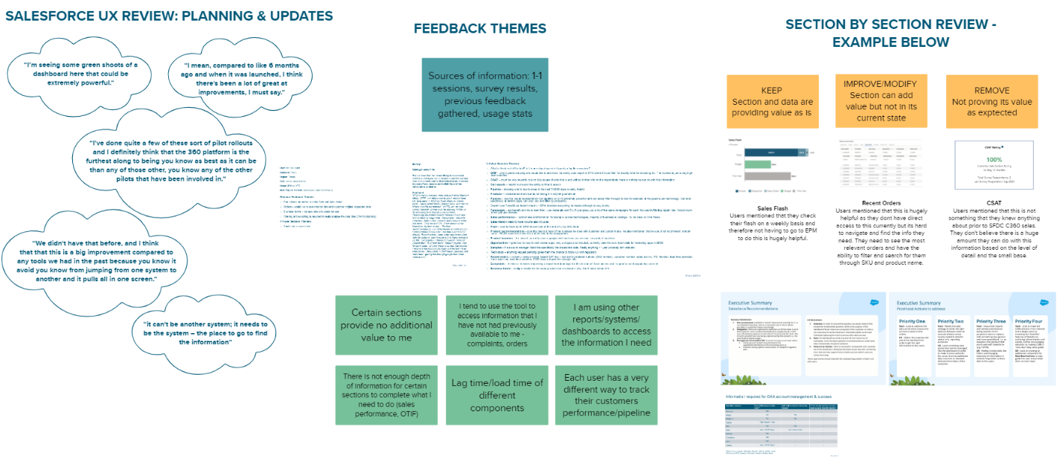
SFDC UX review
C360 SALES PRODUCT

Slide 8
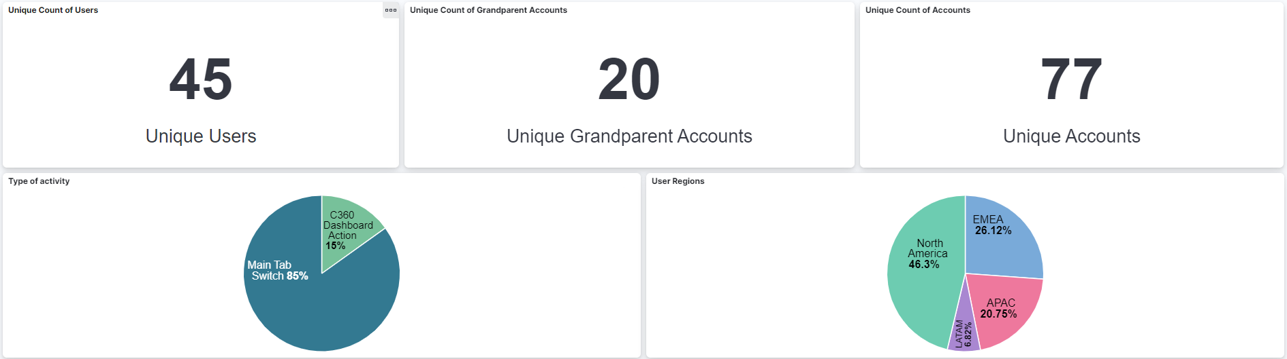
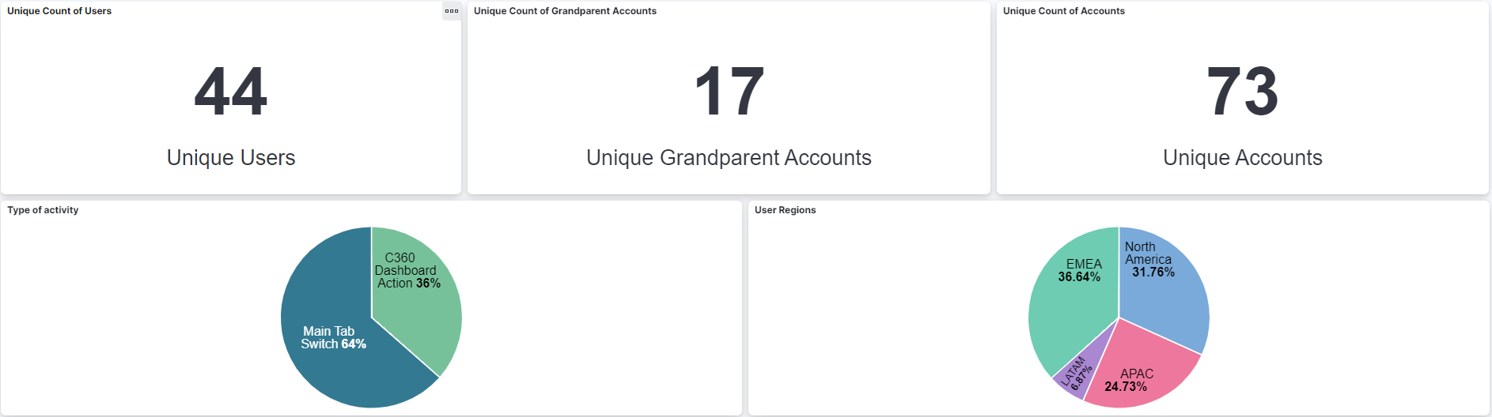
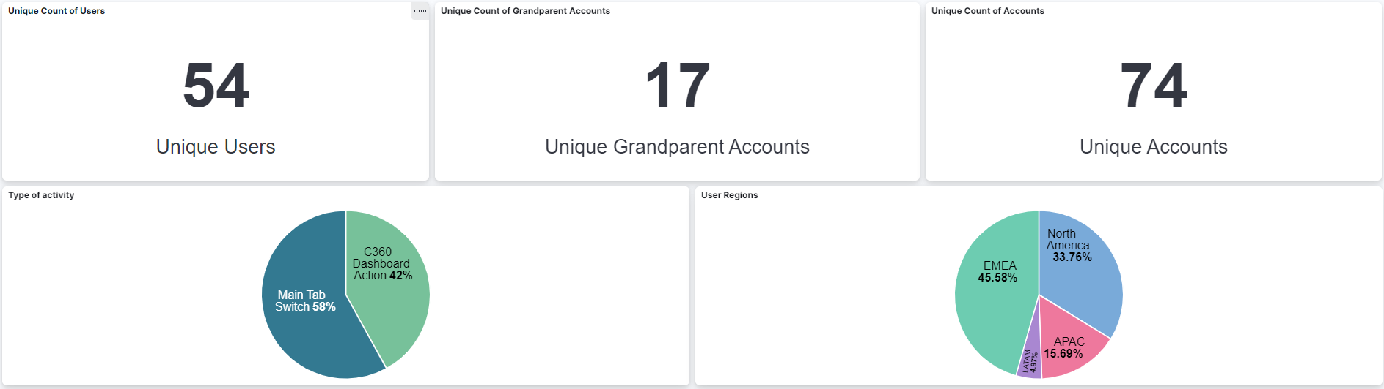
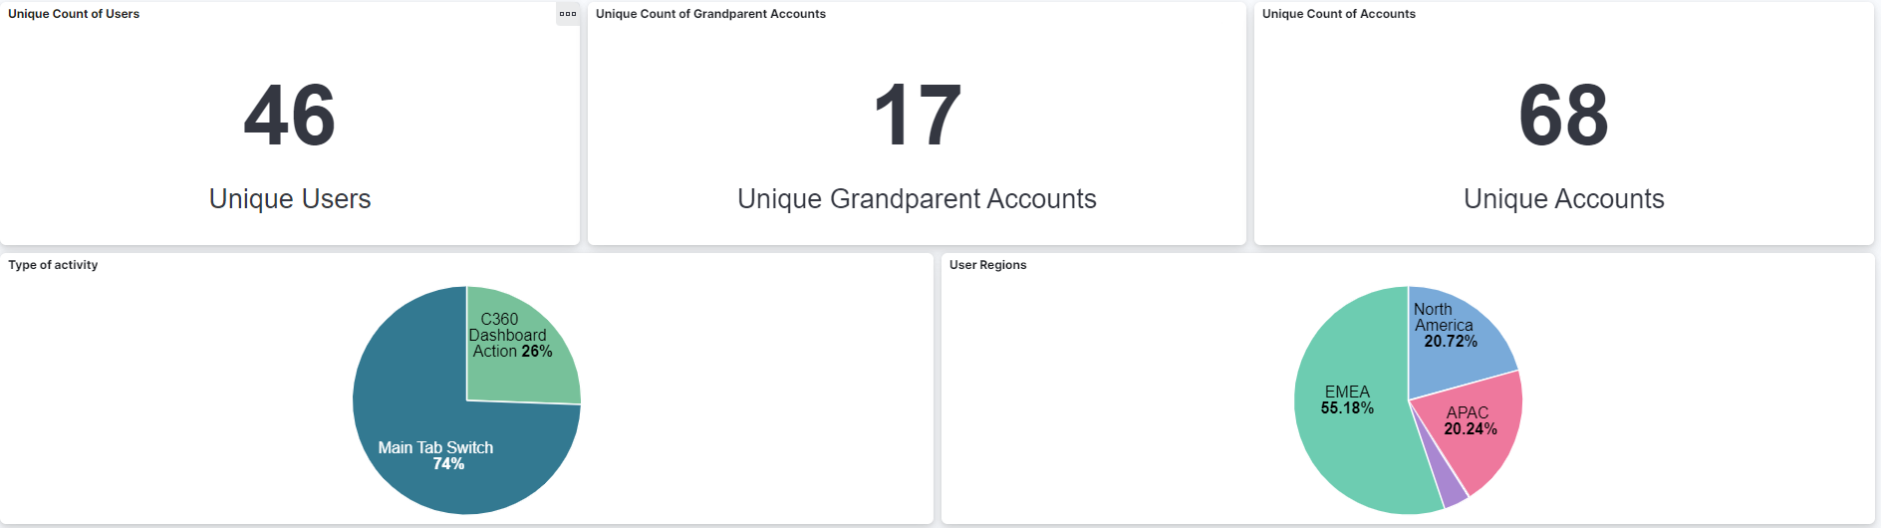
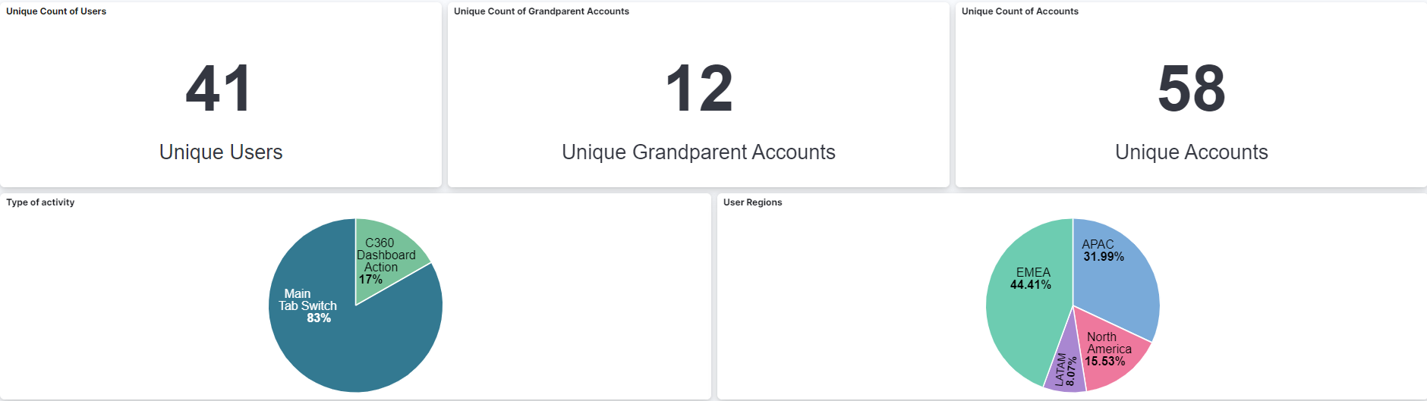
Current adoption rates
C360 SALES PRODUCT
JANUARY
FEBRUARY
MARCH
APRIL
MAY

Slide 9
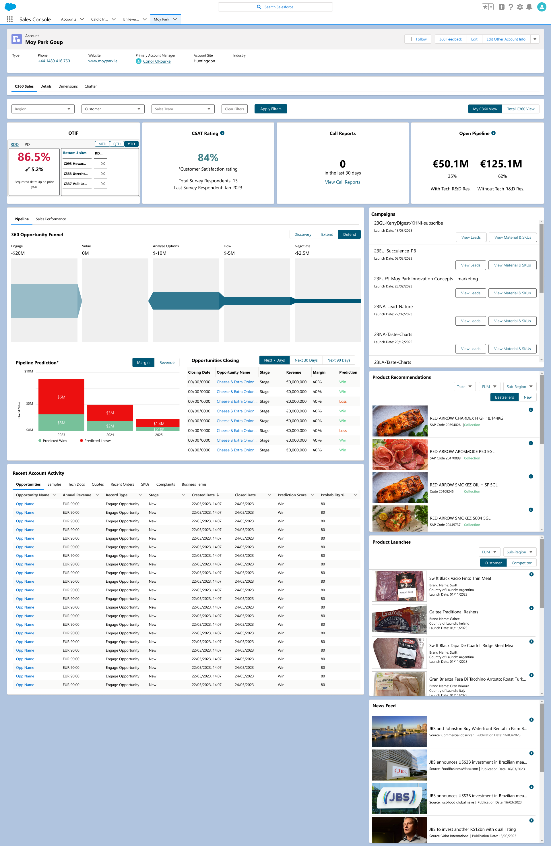
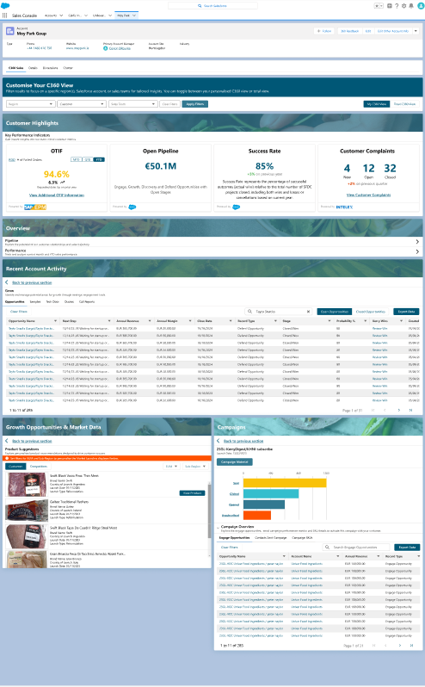
Current product versus new design
C360 SALES PRODUCT

Slide 10
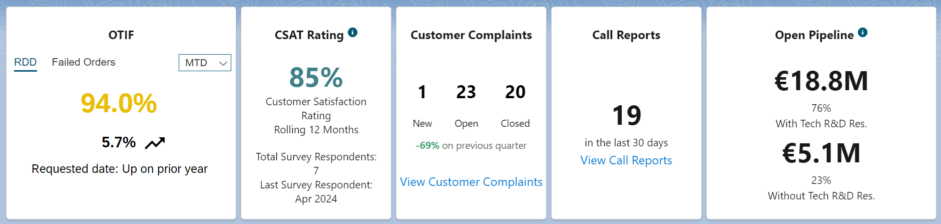
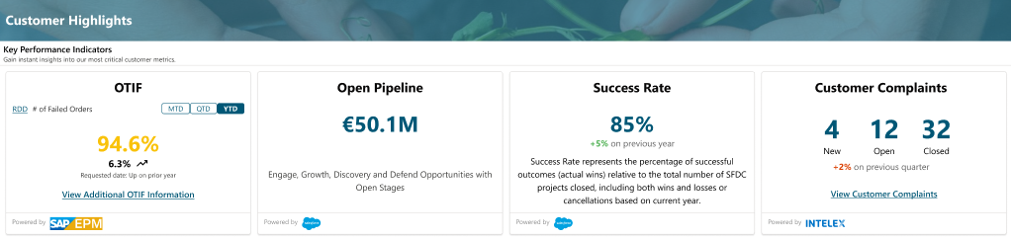
Recent account activity versus customer highlights
C360 SALES PRODUCT

Slide 11
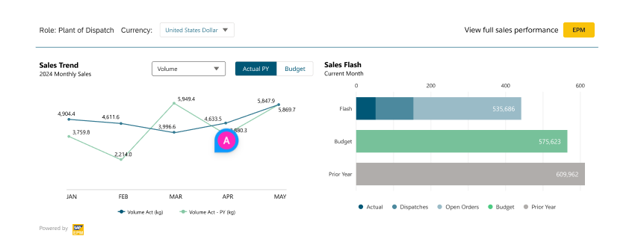
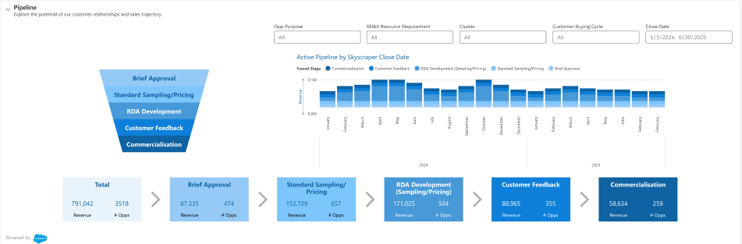
Pipeline & Sales Performance – New design
C360 SALES PRODUCT

Slide 12
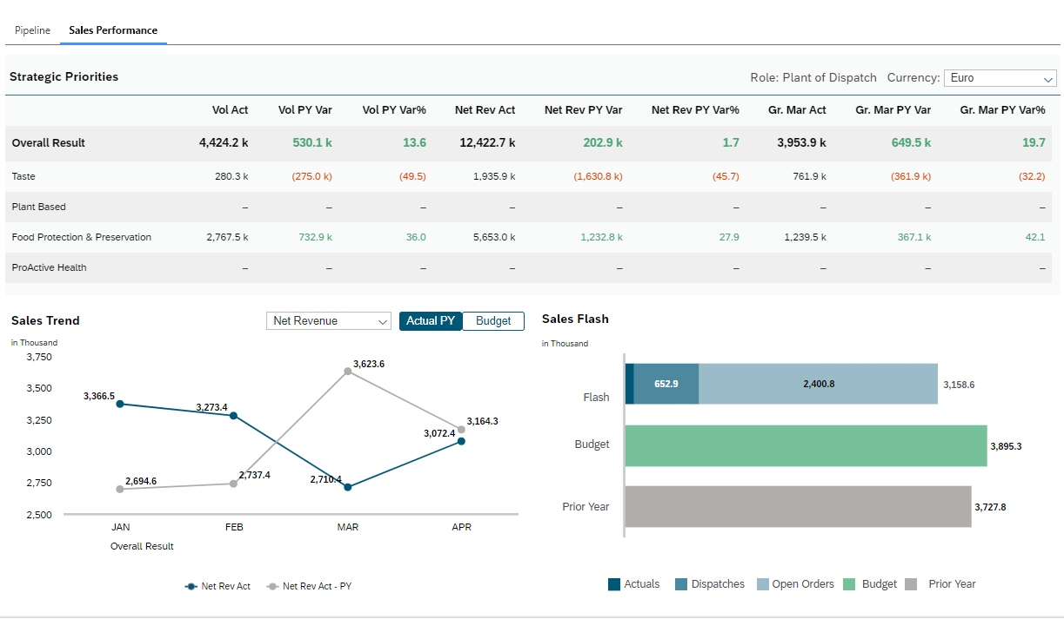
Pipeline & Sales Performance – Current design
C360 SALES PRODUCT

Slide 13
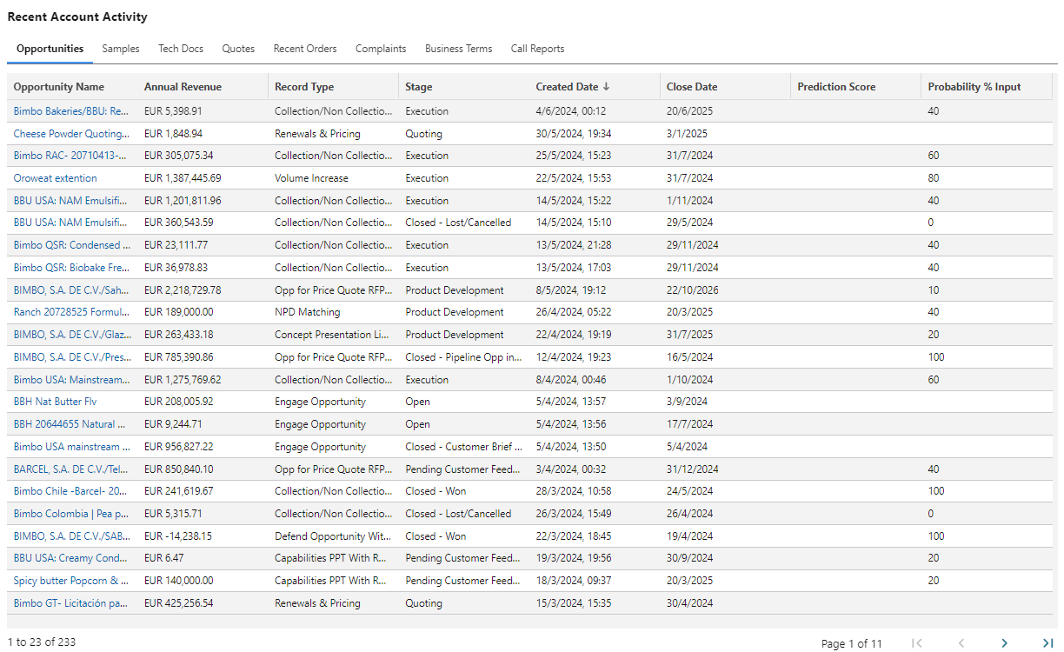
Recent account activity – Current
C360 SALES PRODUCT

Slide 14
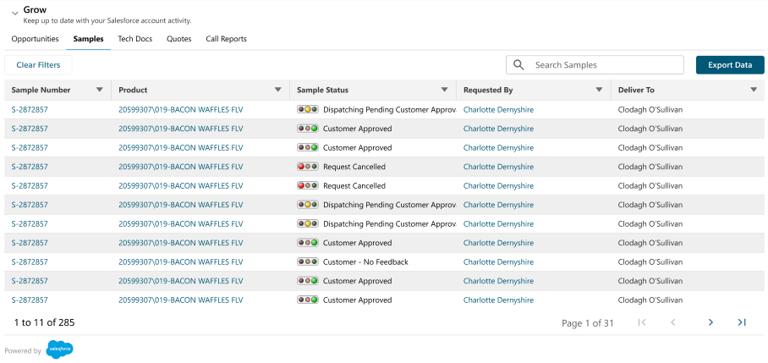
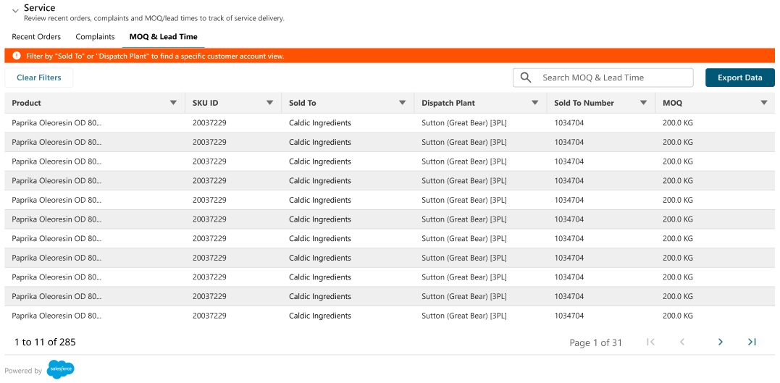
Recent account activity – New
C360 SALES PRODUCT

Slide 15
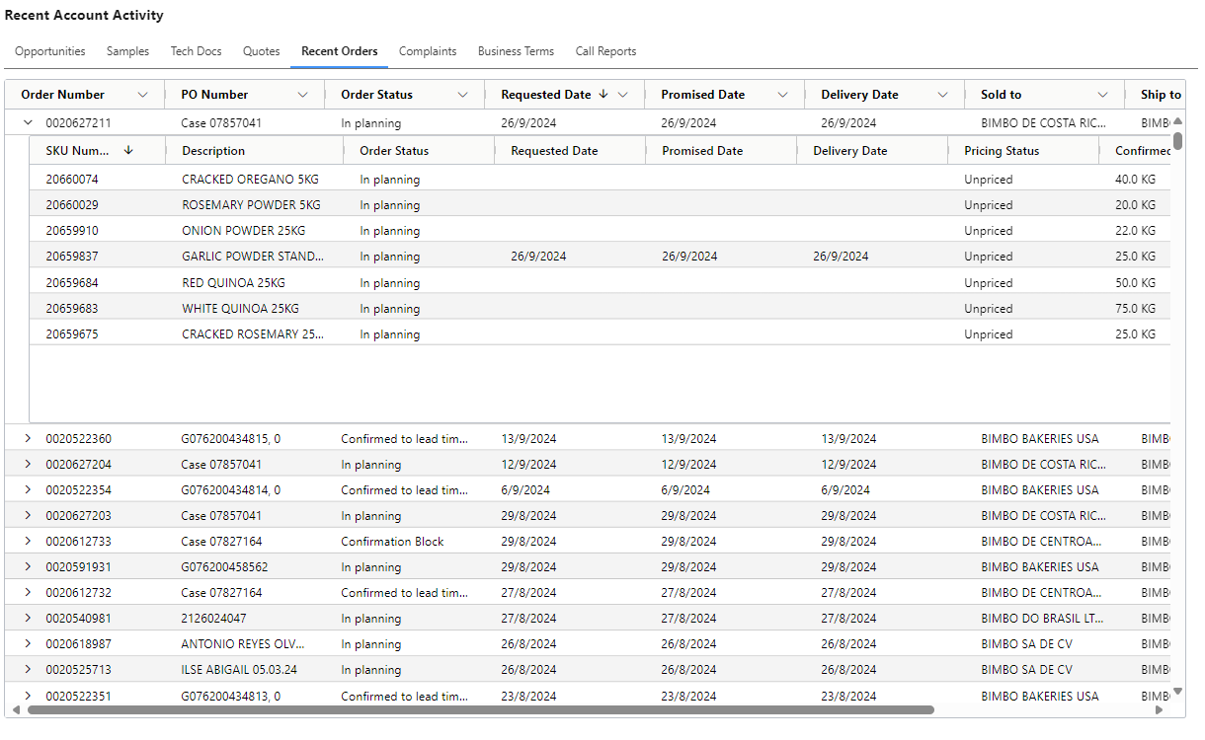
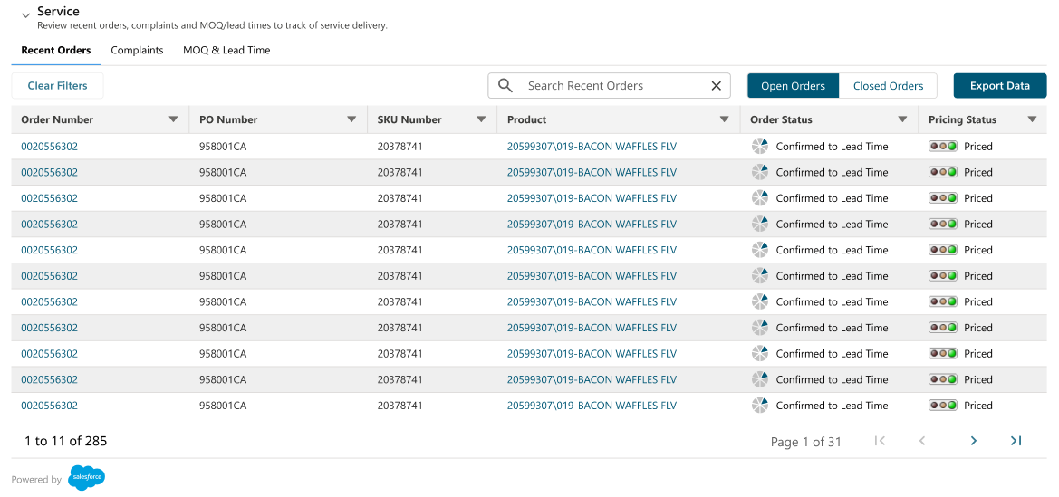
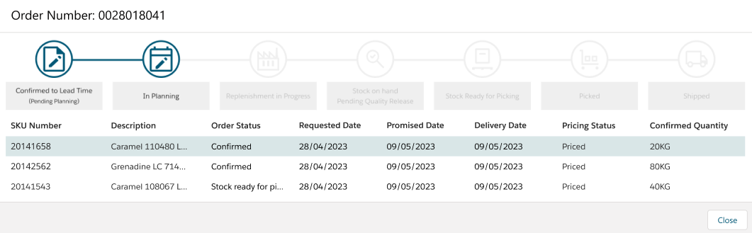
Recent account activity – Orders
C360 SALES PRODUCT

Slide 16
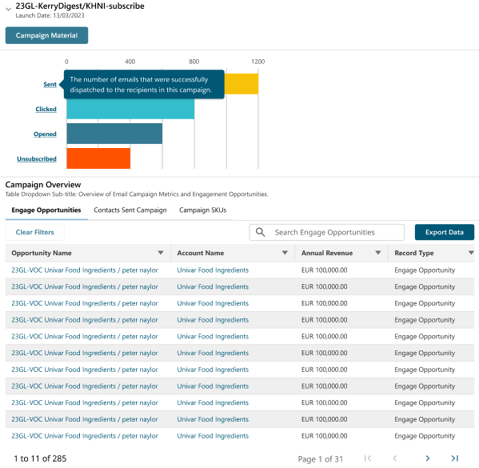
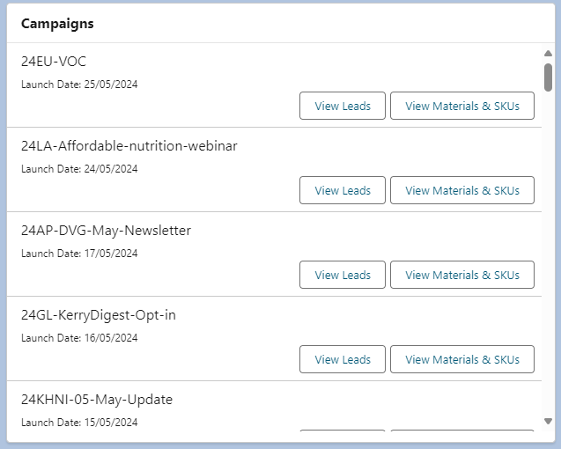
Campaigns
C360 SALES PRODUCT

Slide 17
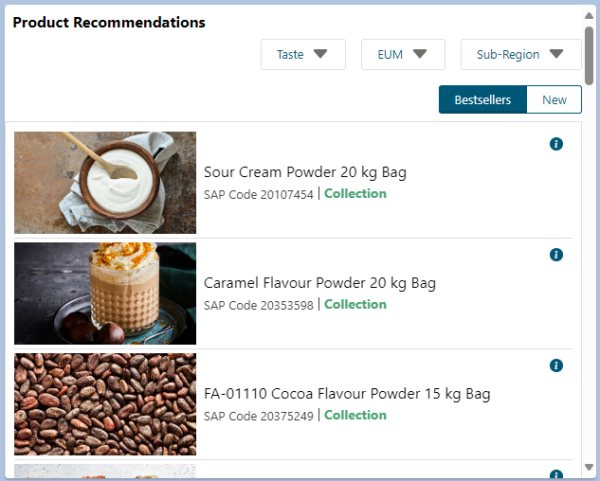
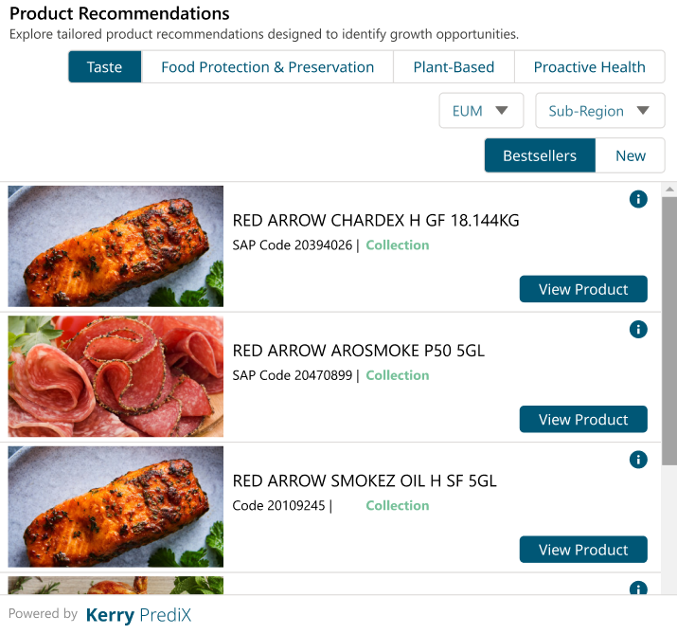
Product recommendations
C360 SALES PRODUCT

Slide 18
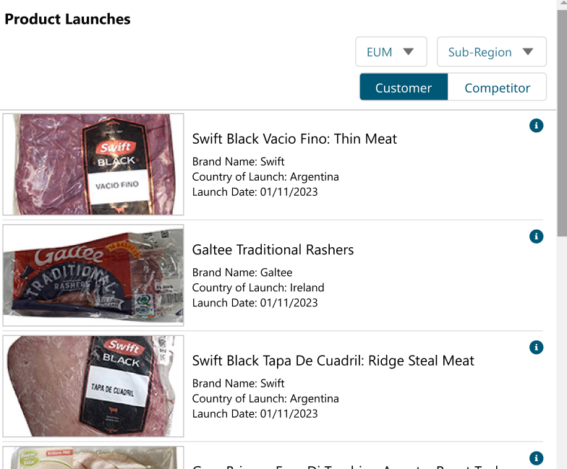
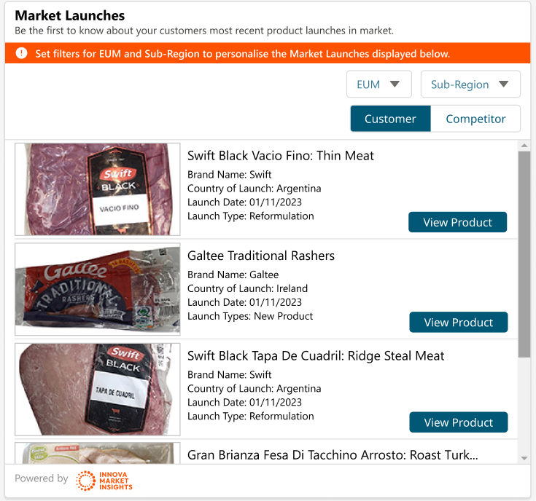
Product / market launches
C360 SALES PRODUCT

Slide 19
Proposed delivery timeline
C360 SALES RELEASE PLAN
C360 SALES | MAY | NE |  |  |  | JULY |  |  |  |  | AUGUST |  |  |  | SEPTEMBER |  |  |  | OCTOBER
WORKSTREAMS | 27TH | 3RD | 10TH | 17TH | 24TH | 1ST | 8TH | 15TH | 22ND | 29TH | 5TH | 12TH | 19TH | 26TH | 2ND | 9TH | 16TH | 23RD | 30TH | 7TH | 14TH | 21ST | 28TH
Design Reviews and Sprint Readiness
Continuous Refinement
Build
Salesforce Testing
Build
Salesforce Testing
Build
Salesforce Testing
Hardening, Regression and Final UAT
Product Launch: Go-Live
Release 1: To be defined
SPRINT 0
PRODUCT LAUNCH
RELEASE 1 Onwards
SPRINT 1
QA
SPRINT 2
QA
SPRINT 3
QA
E2E TESTING
PRODUCT
RELEASE
COMMERCIAL
EVENT
LIVE
HYPERCARE
SPRINT 1
QA
SPRINT 2
QA
LIVE
Confirm timeline works in harmony with SF release and testing cycles
Notes:
Sprint 0: encompasses various activities such as:
creating a backlog,
establishing ways of working,
drafting release plans,
determining what resources are needed for future Sprints etc.
Specifically, to get our new resources onboarded, get backlog set up and get user stories refined/in a state of ‘READY’ (talk about later).
Refinement: Will continue throughout – Colin will talk ore on that. Focus first on our Product Launch, then Releases.
Sprints: Will continue with our 3-week sprints. This 3 weeks will consist of Build, and also incorporate the week for SFDC testing.
Recent changes in environments mean that SFDC can continue to build on that 3rd week in parallel to testing that’s going on.
Need to understand how best to plan/manage that.
Timeline: We have 3 x 3-week sprints pencilled in here – but this is dependent on the backlog we have and the effort required from the team.
We need to confirm if it’s feasible to deliver what’s actually in scope for our August launch.
Hypercare: Strategy TBC – but will likely be our current product team, so will allow for a natural break in sprints there.
Release Approach: Similar to KerryNow – the output of multiple Sprints will be delivered together in a release (so may not release at the end of eachs print as we had been doing all along).

Slide 20
Foundry introduction
NEW OPERATING MODEL
PAST 18 – 24 MONTHS
RECENTLY
TODAY and BEYOND
Have an existing Commercial Enablement Plan
Contains a number of digital products
Mix of delivery approaches
KerryNow MVP launch
Further KerryNow product releases
Established a good foundation for agile ways of working
Recognised the successes of the past that include a balanced way of working and delivering well
Looked to introduce additional structure to help prioritise new digital demand
Introduced the foundry to manage resources and underlying capabilities to deliver on the that demand
Establish and scale foundry ways of working to other teams, C360 Sales today and others in the future
Ensure team efforts are balanced and sustainable
Implement consistent operations and metrics
Keep moving forward and enable mature digital product teams that support us in achieving our commercial goals

Slide 21
Ways of working
SESSION 2

Slide 22
Common agile roles and high-level responsibilities
WAYS OF WORKING
Foundry manager | Responsible for embedding and running the foundry, and continuous improvements of its operation and structure. Has a focus on scaling consistent ways of working to workstreams onboarded into the foundry. Responds to resource demands and allocation based on digital pipeline.
Product owner | Represents the customer and owns the overall product vision, roadmap, release goals and priorities. Responsible for managing the product backlog and ensuring the team works against high-value deliverables as defined by business.
UX/UI designers | Conducts user research and drives a solution vision based on business and user insights. Designs intuitive experiences represented by wireframes and validates those visual designs with users and/or product owners.

Slide 23
Common roles and high-level responsibilities
WAYS OF WORKING
Agile delivery lead | Knowledgeable in agile methodologies and practices, with an ability to educate others. Aware of the daily operations of multiple workstreams and typically functions at the scrum of scrum level. Develops foundry level capacity and release plans to align teams with agreed milestones and delivery targets.
Scrum master | Servant leader that works with the scrum team daily, ensuring appropriate methodology is adopted, housekeeping is in check, and impediment / blockers are removed to ensure flow throughout the delivery. Can cover one or more scrum team, responsible for reporting on each to the agile delivery lead, which includes relevant metrics.
Technical architect | Assists with the overall architectural design in line with digital strategies and IT standards. Guides the team regarding technical options and solutions.
Scrum team | A cross-functional team of business analysts, developers and testers, focusing on the definition, delivery and quality assurance of digital product, built using the scrum methodology and cadence. In the foundry, a scrum team can consist of multiple sub-teams aligned to a technical domain.

Slide 24
WAYS OF WORKING
CCO Steering Committee
Lisa Wilkinson
Sander Brakel
Ben Hallinan
Piotr Iwanicki
Commercial Excellence Director
Senior Digital Commercial Director
VP Customer Experience
Digital Enablement Lead
C360 Sales Leadership
Orla Stafford
Product Owner
Gillian McKenna
Platform Lead
Ciarán Dooley
Portfolio Lead
Chris Reidy
Agile Delivery Lead
Scrum Team Enablement
Miko Lagbas
Business Analyst
Colin Bond
Business Analyst
Niamh Lawlor
Scrum Master / PM
EXTERNAL
UX
Salesforce Development
Canvas App Frontend
Canvas App Backend
Data
ICT Enablement
EPM / SAC
Kevin O’Connell
Aniket Piralkar
Ferenc Kurucz
Jens Michels
Brian Ward
TBC
UX Lead
Salesforce Developer
Technical Architect
Data Engineer
SAP Integration Lead
EPM POC
Austin
Khalid Mateen
Divya K
Gita Yadav
Marina ElDib
Bryan Tobin
Business Enablement
UX Designer
Salesforce Developer
Frontend Developer
Backend Developer
Data Engineer
Security Manager
Inno Bulasag
Odhran McHugh
Ann-Marie Dunny
QA / Testing
Change & Comms Lead
ElasticSearch & Kibana Developer
Data Scientist (Recommendations)
Gowtham Kumar
Quality Analyst

Slide 25
Functional decomposition
WAYS OF WORKING
Business Requirement / Need / Capability
Epic
Feature
User Story
User Story
Split Story
Split Story
Split Story
User Story
Feature
Split Story
UX design / Wireframe
Each piece of functionality starts with a vision which is transposed into wireframes in collaboration with our PO/ UX team.
The wireframes are interpreted by our BA, who decides if the new functionality fits into an existing epic or if a new one needs to be established.
After an epic is selected / defined and assigned, the BA sets about focusing on the related feature. Similarly, a decision will be made to use an existing feature if applicable or create a new one if needed.
Features are too big for developers to commence working on! These are further broken down into smaller chunks, known as user stories that developers can typically build within a sprint. Tasks can be used for non development work.
The development team review user stories to ensure the requirement is understood and no details are missing from a technical standpoint. A ‘spike’ may be required to investigate technical solutions. In our world, user stories are often split by capability depending on the nature of the work. E.g., Salesforce, Canvas

Slide 26
Backlog composition
WAYS OF WORKING
New Feature Functionality: This covers brand new, never seen before functionality which is being added to the dashboard.
PRODUCT BACKLOG
New Feature / Functionality
Optimisation: These are improvements that the team are looking to make to existing functionality on the dashboard.
Optimisation
Refactoring: Involves improving the codebase of an existing feature or system without changing its external behavior.
Refactoring
Bugs / BAU
Bugs/BAU: These are related to existing functionality which is not working as originally intended.
Technical Parking Lot
Unit Test Coverage
Technical Parking Lot: List of technical tasks or issues that have been identified during the development process but are not currently a priority for the team.
Unit Test Coverage: This type of story may involve tasks such as a) writing new unit tests to cover previously untested code, b) improving the quality of existing unit tests, or c) increasing the overall coverage of the codebase.

Slide 27
User story refinement activities
WAYS OF WORKING
WE ARE HERE
Focus in the near term
Functional decomposition
Confirm epics and features in scope for PRODUCT LAUNCH
Create a list of draft, related user stories
Provide an initial prioritisation of user stories
Shaping and sizing
Per feature, review the UX/UI design and drafted user stories to determine
  User story splits per technical domain
  Technical complexity of the requirement
  High-level estimations for user stories within a feature
Once completed for all features, the Product Owner, Agile Delivery Lead and Foundry Manager will review team capacity, overall effort required, user story prioritisation, delivery timeline and resource mix to determine if changes are needed to meet the release scope
Sprint 1 user story refinement
Following the definition of ready (DoR) requirements, build a backlog of prioritised user stories for the first sprint.
A tagged, refined and estimated user story
User story refinement for sprint 2
User story refinement for sprint 3
Release Tracker
Focus after the Product Launch release
Embed the foundry way of working for regular release cycles:
  Focus on release 1 user story shaping, sizing, and refinement
  Aim to have a backlog of 2 sprints worth of requirements agreed prior to the first sprint of the release

Slide 28
Definition of ready
WAYS OF WORKING
PROPOSED CHECKLIST
  User story has a clear business definition that includes context, and why the story is required
  User story contains a user story description (format) and appropriate acceptance criteria
  User story has links to UX/UI designs and process maps if applicable
  User story is split based on technical domain where needed, with attached technical documentation when available, e.g., YAML files, data flow diagrams, payloads, DevOps wiki page links
  Story is assigned to a relevant parent, i.e., Epic, Feature, Story
  Story Sub-tasks have been created if required
  Story points have been estimated
  Story is assigned to a relevant sprint
  Dependencies are identified, linked to the story, and ready for development in their own right
  Open questions for the story are resolved / closed
The Definition of Ready (DoR) is used to ensure that user stories are adequately prepared and refined before they are brought into a sprint for development.
User stories that have not met this definitions are not expected to be eligible for the upcoming sprint and should not be discussed during sprint planning.
Correlates to the user story status: Ready for Dev

Slide 29
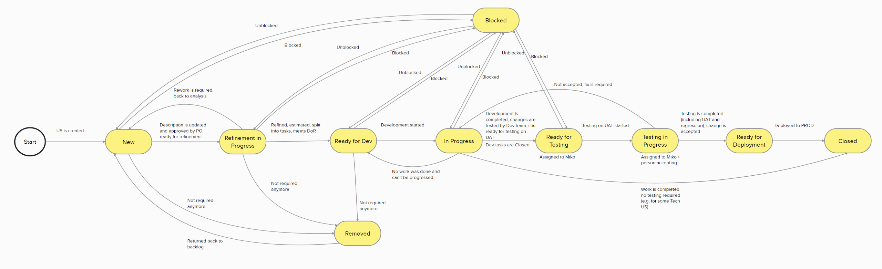
User story lifecycle
WAYS OF WORKING
The lifecycle of a user story remains largely untouched. The foundry is considering a new ‘On Hold’ status that will be available during refinement.
Capture any additional amendments the team might want to consider.
Share and review the foundry defect lifecycle when finalised.
Link to Backlog

Slide 30
Ways of working continued
SESSION 3

Slide 31
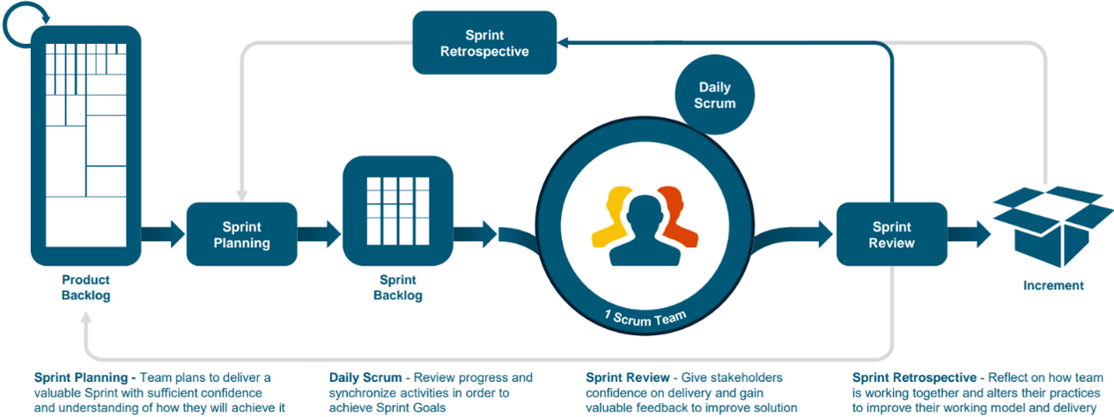
Agile methodology
WAYS OF WORKING
A sprint is at the heart of Scrum. It is a time-boxed period, during which a usable, potentially releasable digital deliverable is created.

Slide 32
Digital foundry approach
WAYS OF WORKING
SCRUM CEREMONIES | FOUNDRY SPECIFICS
Preparation | Capacity planning will move to a weekly activity, managed by the Agile Delivery Lead. This includes holiday, and other time-off tracking. Initially, 1 story point per day will be used to calculate sprint effort. Thereafter, velocity for the Canvas and Salesforce team will be used.
Sprint planning | Starts with a quick capacity review to confirm number of story points per sprint. User stories are allocated per technical domain and the sprint goal is documented and communicated.
Daily standups | Bugs will be covered first, followed by a review of the sprint board, by team. Additional stories can be brought into the sprint if capacity allows, this needs Scrum Master and Business Analyst approval.
Sprint review | Stakeholders will be invited based on sprint deliverable. Breakout rooms might be established, but not envisaged at this stage.
Sprint retrospective | A dedicated C360 Sales retrospective will be held and function in the same way.
Confirm approach for capturing sprint goals; Mural or DevOps
Product Owner to define audience for Sprint review based on sprint deliverables

Slide 33
Proposed meeting cadence
WAYS OF WORKING
 | WEEK 3 | JUNE
WORKSTREAMS | MON | TUES | WED | THUR | FRI
9:00
10:00
11:00
12:00 | LUNCH
13:00
14:00
15:00
WEEK 1 | JUNE
MON | TUES | WED | THUR | FRI
LUNCH
WEEK 2 | JUNE
MON | TUES | WED | THUR | FRI
LUNCH
Digital CM
Digital CM
Digital CM
Canvas Tech Call
Refinement Call
Refinement Call
Refinement Call
Refinement Call
Refinement Call
Refinement Call
Daily Standup
Daily Standup
Daily Standup
Daily Standup
Daily Standup
Daily Standup
Daily Standup
Daily Standup
Daily Standup
Daily Standup
Daily Standup
Daily Standup
Daily Standup
Daily Standup
Daily Standup
Review Prep
Sprint Review (Demo)
Sprint Planning
Sprint Retro
Refinement
Refinement
Refinement
Confirm cadence based on team feedback
Be mindful of time-zones and team availability / allocation

Slide 34
Introducing team velocity
WAYS OF WORKING
Estimating team capacity and measuring team velocity is critical to predictability.
Determine development capacity
Capacity is the amount of time (in story points) that a team member can dedicate to a sprint.
This time is reduced by effort required on other projects, design work, sprint events, testing and/or release activities if the sprint is a release sprint.
Development capacity is an accumulation for each team member, by technical domain
Track scrum team velocity
Velocity is the average number of story points completed by a team in a single sprint.
This is tracked per team member, by technical domain.
Determine development capacity, using velocity
Average velocity (calculated for all pre-ceding sprints) is used as an input during capacity planning to determine the number of story points a team, or team member can complete for this future sprint.
A capacity tracker will help track the progress of the team, allowing us to become better at predicting what can be delivered and by when.
CAPACITY TRACKER
Get an idea of team capacity
Clarify and align key focus areas
Understand and track team velocity
Allow more accurate planning for releases and go-lives

Slide 35
Capacity planning in action
WAYS OF WORKING
Establishing a capacity tracker enables us to plan for sprints more accurately.
EXPLAINER
SESSION 1
15 days per sprint (3 weeks)
Assume each developer is able to deliver 1 story point per day, 15 story points per sprint
Capacity = days per sprint x availability %
Where, availability % will vary by developer, by sprint
Availability % can be increased or decreased depending on the sprint context
  E.g., for a release sprint, availability % is normally decreased due to release and testing activities
Allows us to take other project work, holidays and PTO into account
The details need to be worked through together!

Slide 36
Definition of done
WAYS OF WORKING
PROPOSED CHECKLIST
  Unit tests are passed in the local environment
  Code/configuration has passed peer review and meets development standards
  Code is commented, checked-in and is run against current configuration in source control
  Builds are without errors
  Every deployment request has an associated work item
  Code/configuration migration process has been documented and code/configuration has been promoted to the QA environment
  Test scripts have been developed based upon approved acceptance criteria
  Documentation has been drafted and/or updated
  Functional requirements are met, and functional tests passed, OR
  API requirements are met as per the defined specification, and API integration tests passed
  The front-end needs to be user accepted before released to production
  The respective work items are closed when promoted to production
The Definition of Done (DoD) serves as a set of standards that must be met for a user story, task or feature to be considered complete.
It ensures that all work meets a consistent level of quality before it is considered complete and helps to mitigate the risk for defects.
It is expected that the DoD criteria is met prior to deployment to any environment i.e. a developer must complete the necessary reviews and testing in their local environment first for a story to be considered complete, and before it can be passed to the quality team.
Review and agree DoD for each technical domain

Slide 37
Closing Q&A

